Slide 1
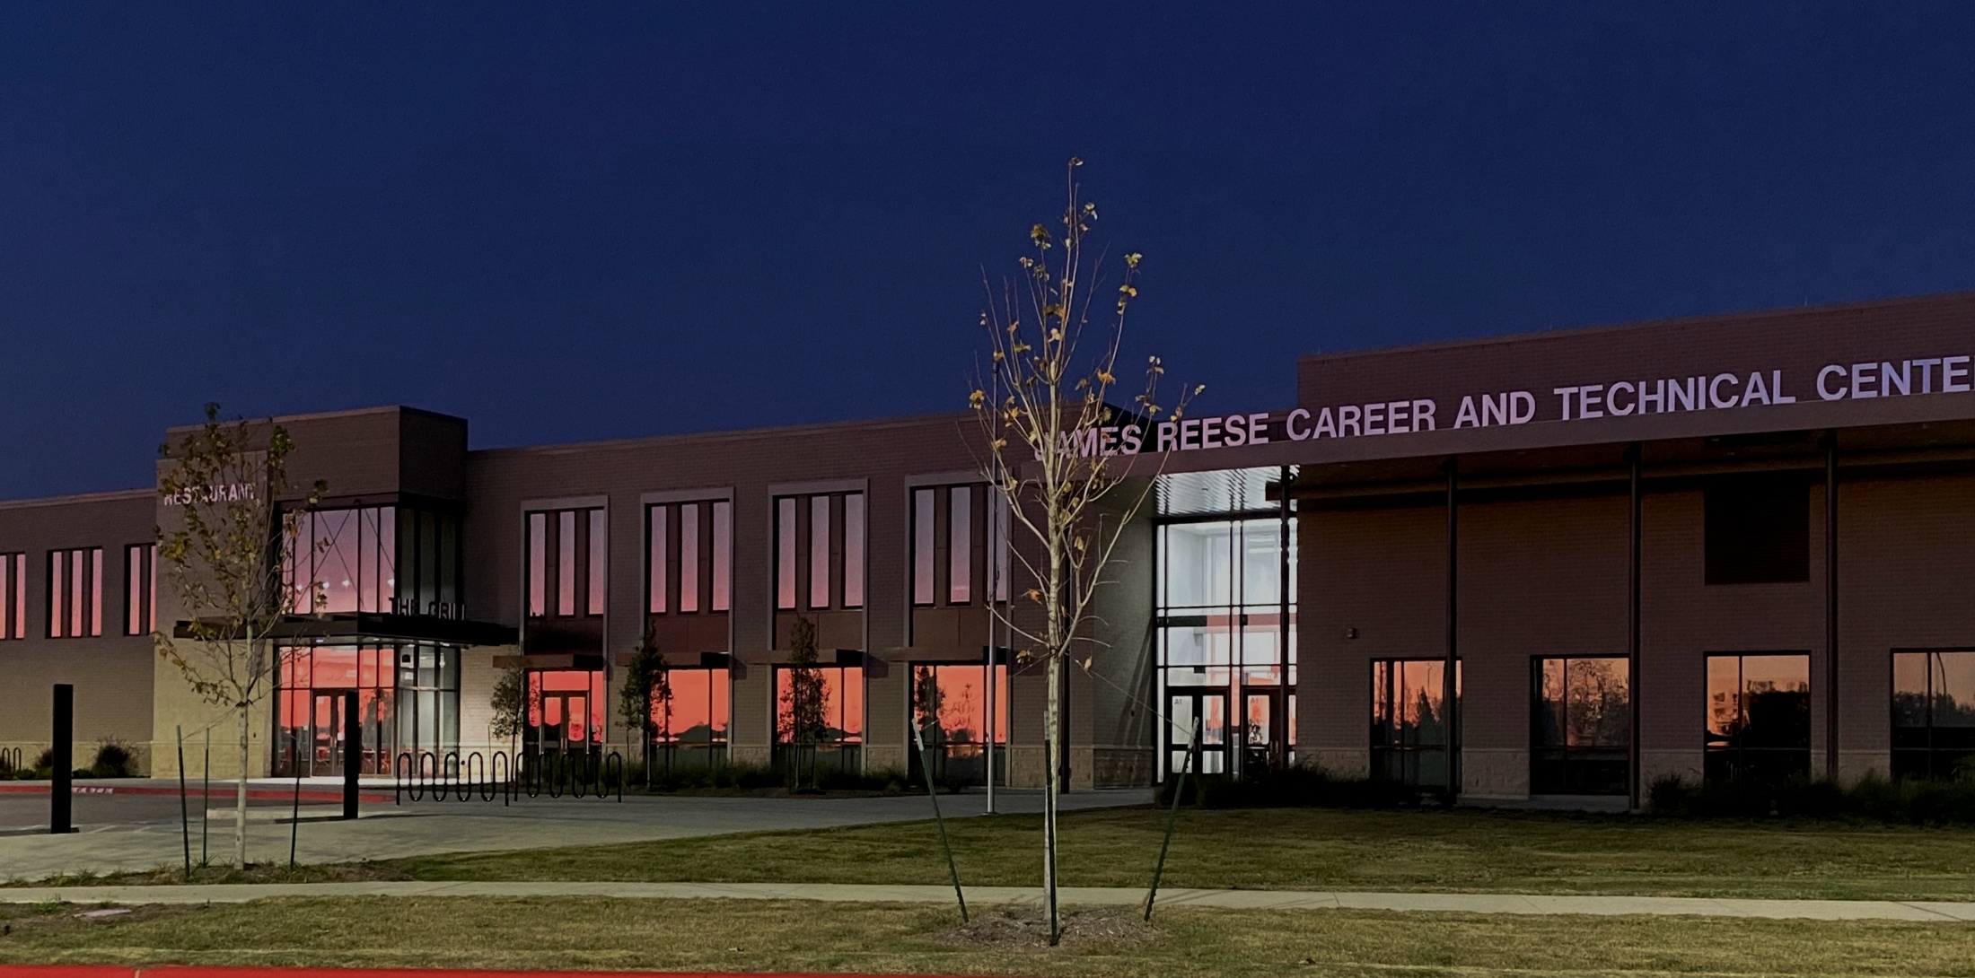
What is CTE?
1-25-2022

Slide 2

Tonight’s Program
What is CTE?
Why is CTE so important?
How do students access CTE?
What do the professionals say?

Slide 3
CTE Mission Statement
The Career and Technical Education Department provides challenging career pathways for every student utilizing real world practices and evolving skill sets, attitudes and behaviors.
Notes:
In 2014, we engaged many stakeholders as we developed a mission statement that would guide the work for CTE.
Teachers
Parents
Students
Business and Industry
Texas State Technical College

Slide 4
What is CTE?
So, what is Career and Technical Education?

Slide 5
What is CTE?
Coherent Sequence of Courses
Pathway
Program Area

Slide 6
Program Areas
Agriculture, Food, & Natural Resources | Architecture & Construction | Arts, Audio / Video Technology, & Communications | Business, Marketing, & Finance
Education & Training | Health Science | Hospitality & Tourism | Human Services
Information Technology | Junior Reserve Officers’ Training (JROTC) | Law & Public Services | Manufacturing
 | STEM | Transportation, Distribution, & Logistics

Slide 7
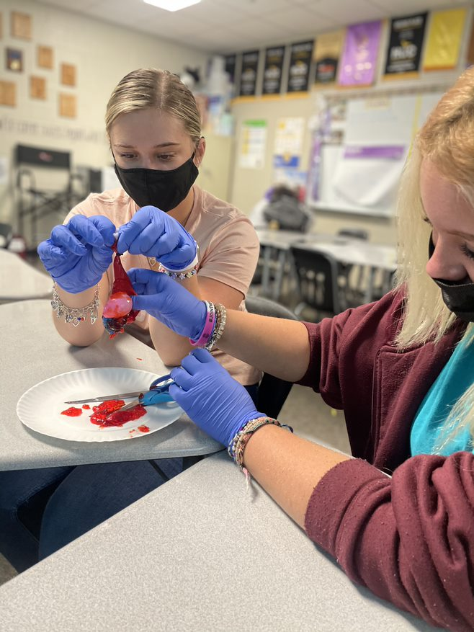
What we teach…
Agriculture, Food and Natural
Resources
Animal Science
Floral Design
Architecture and Construction
Architectural Design
Electrical
HVAC

Slide 8
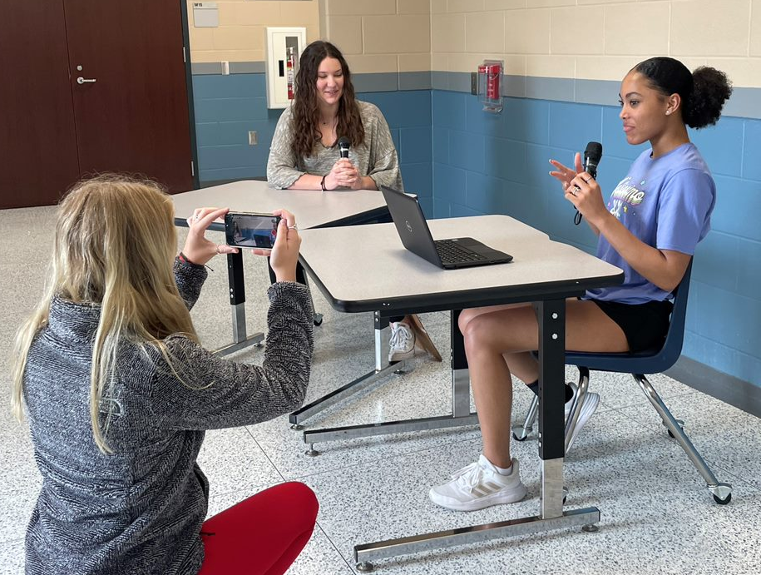
What we teach…
Arts, Audio/Video
Technology, &
Communications
Digital Communications
Business, Marketing, and Finance
Business Management
Marketing and Sales

Slide 9
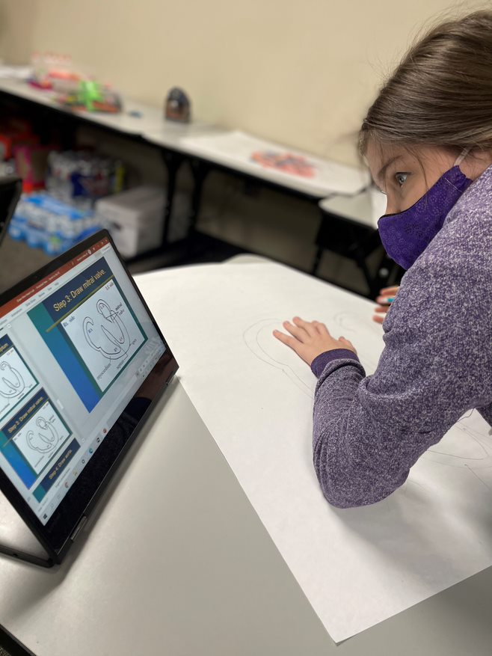
What we teach…
Education and Training
Teaching and Training
Health Science
Healthcare Therapeutic
Hospitality and Tourism
Culinary Arts

Slide 10
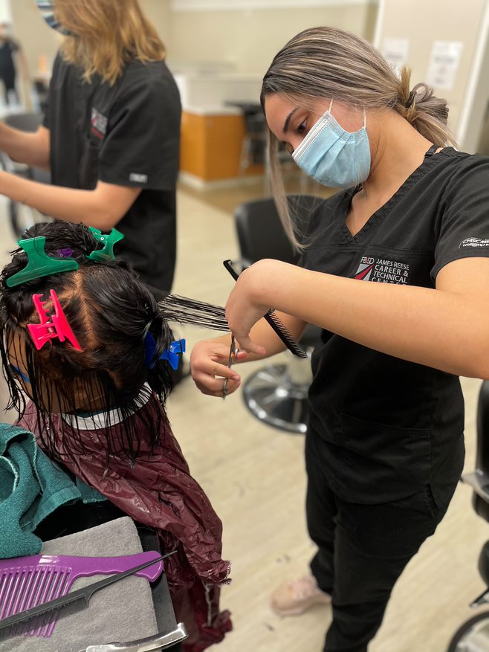
What we teach…
Human Services
Cosmetology
Family and Community Services
Information Technology
Networking Systems
JROTC

Slide 11
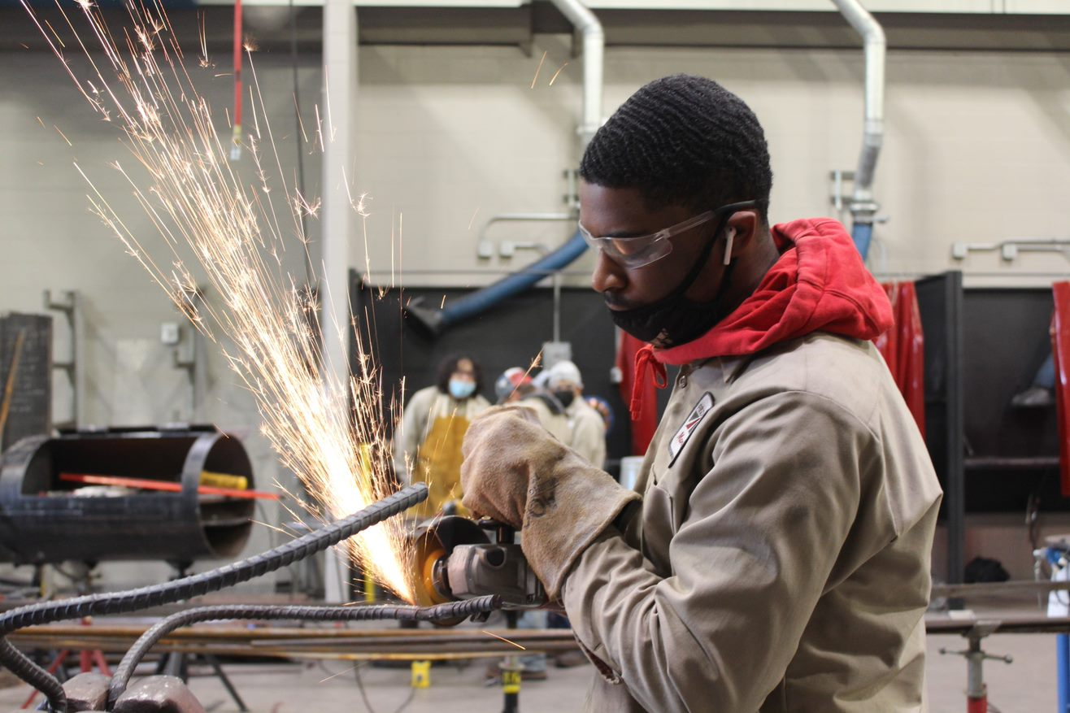
What we teach…
Law and Public Service
Emergency Services
Law Enforcement
Manufacturing
Welding

Slide 12
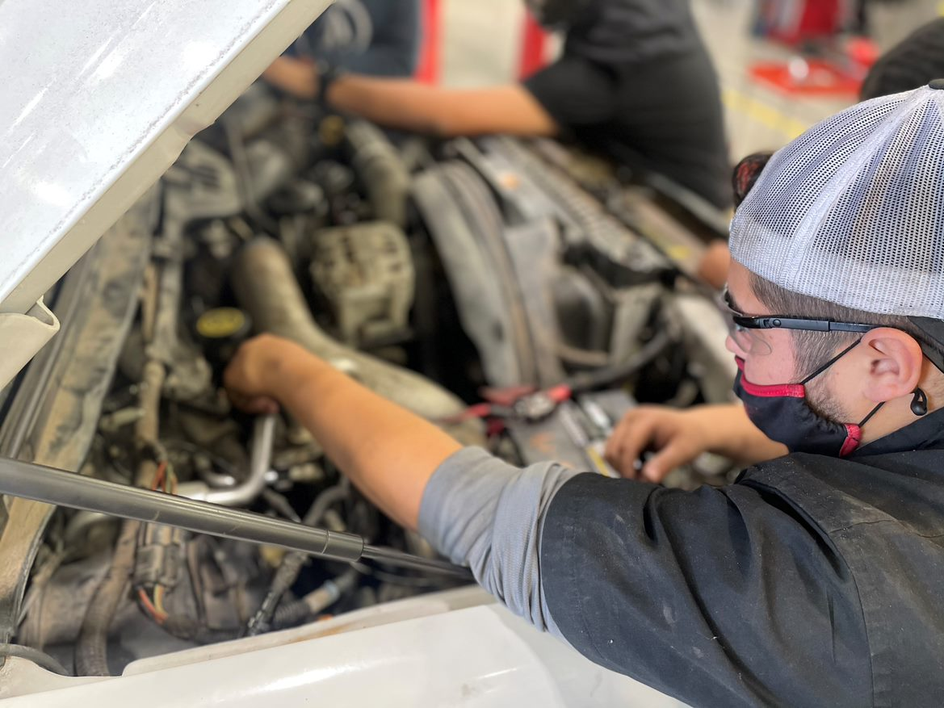
What we teach…
STEM
Engineering
Programming and Software Development
Transportation, Distribution, and Logistics
Automotive
Diesel Mechanics

Slide 13
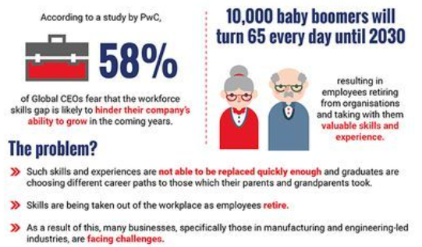
Why CTE?

Slide 14
Why CTE?
Competitive Advantage
Culture and Mindset
21st Century Skills Attainment
Rigorous Coursework Leading to Industry Certifications

Slide 15
Accessing CTE
Middle School Options
Universal Course Selection at High Schools
Specialized Campuses
  James Reese Career and Technical Center
  P-TECH
  Academies

Slide 16
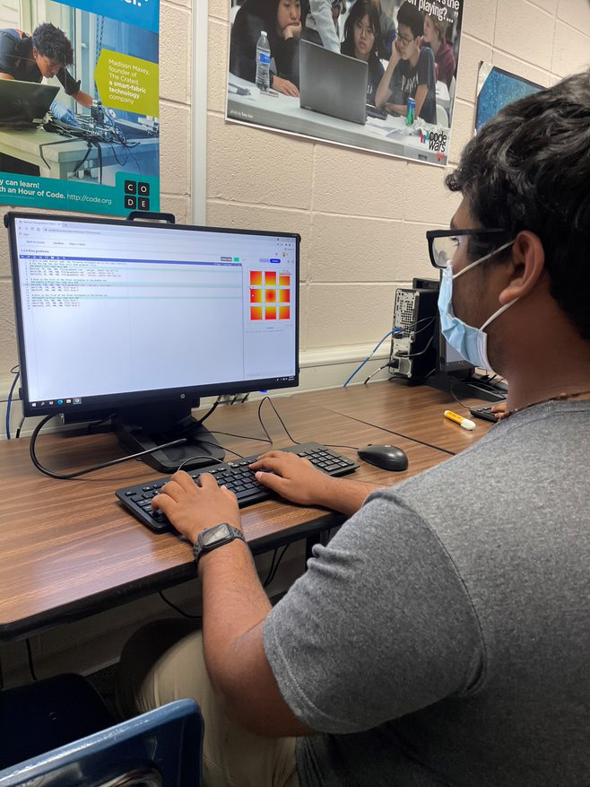
Accessing CTE
Make a plan
Take opportunities to start early
Engage in multiple options

Slide 17
Guest Panel
Makenzie Raesner
Angela Cotie
Assistant Chief Michelle Allen
Ali Hyder Dhukka
Christine Potter

Slide 18

@FBISD_CTE
CTE Program Exploration: Feb. 1 (Virtual Event)
Reese Experience Night: Feb. 10 (In-Person)

